Slide 1
Topic 1: Fundamentals of Logical Algebra
CST205 Digital Logic

Slide 2

Binary Code
Binary Coded Decimal (BCD)
Binary coded decimal (BCD) is a way to express each of the decimal digits with a binary code.
A number with k decimal digits will require 4k bits in BCD.
Decimal 396 is represented in BCD with 12bits as 0011 1001 0110, with each group of 4 bits representing one decimal digit.
A decimal number in BCD is the same as its equivalent binary number only when the number is between 0 and 9.
The binary combinations 1010 through 1111 are not used and have no meaning in BCD.

Slide 3
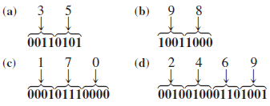
Decimal to BCD conversion
Convert each of the following decimal numbers to BCD.
(a) 35 (b) 98 (c) 170 (d) 2469
Solutions:

Slide 4

BCD to decimal conversion
Convert each of the following BCD codes to decimal:
(a) 10000110 (b) 001101010001
(c) 1001010001110000
Solutions:

Slide 5
Gray Code
The Gray code has no specific weights assigned to the bit positions.
The important feature of the Gray code is that it exhibits only a single bit change from one code word to the next in the sequence.
Its primary use is:
Error detection.
Representation of analog data.
Low power design

Slide 6
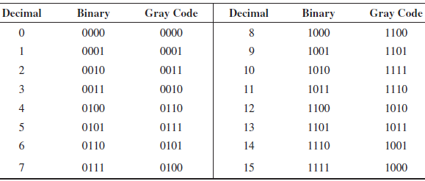
Decimal, Binary, Gray Code

Slide 7

Binary-to-Gray code conversion
The following rules are used to convert from a binary number to a Gray code word:
The most significant bit MSB (left most) in the Gray code is the same as the corresponding MSB in the binary number.
Going from left to right, add each adjacent pair of binary code bits to get the next Gray code bit. Discard carries.

Slide 8

Gray-to-binary conversion
The following rules are used to convert from a Gray code word to a binary number:
The most significant bit MSB (left most) in the binary number is the same as the corresponding MSB in the Gray code.
Going from left to right, add each binary code bit generated to the Gray code bit in the next adjacent position. Discard carries.

Slide 9


Example of binary to Gray code conversion and vice versa
(a) Convert the binary number 11000110 to Gray code.
(b) Convert the Gray code 10101111 to binary.
Solutions:
(a) Binary to Gray code
(b) Gray code to binary

Slide 10
ASCII Character Codes
American Standard Code for Information Interchange (Refer to Table 1.7)
A popular code used to represent information sent as character-based data.
It uses 7-bits to represent:
94 Graphic printing characters.
34 Non-printing characters.
Some non-printing characters are used for text format (e.g. BS = Backspace, CR = carriage return).
Other non-printing characters are used for record marking and flow control (e.g. STX and ETX start and end text areas).

Slide 11
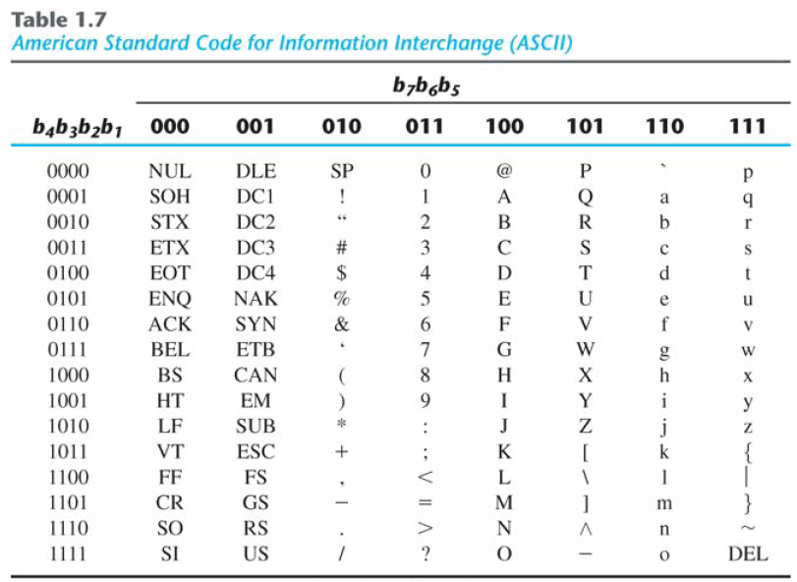
ASCII Character Codes

Slide 12
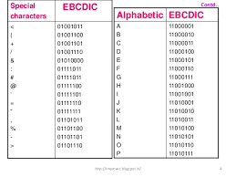
EBCDIC Codes
Extended Binary Coded Decimal Interchange Code (EBCDIC)

Slide 13
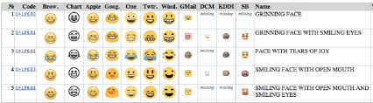
Uni Code
Everyone in the world should be able to use their own language on phones and computers.
It’s a 32/64 bit code which represent all the characters and emoji, visual representation etc.

Slide 14
Logic circuit
Digital logic is the manipulation/ operation of binary values through logic gates to act as switches. They open to pass on a pulse of electricity or close to shut it off.
There are three (3) Primary gates/logical operation: OR AND & NOT and four (4) secondary gates: NAND, NOR, XOR & XNOR.

Slide 15
Boolean Constants and Variables
Boolean variable is a quantity that may be equal to either 0 or 1 at different times.
For example, in a certain digital system the Boolean value of 0 might be assigned to any voltage in the range from 0 to 0.8 V while the Boolean value of 1 might be assigned to any voltage in the range from 2 to 5 V (Note, voltages between the 0.8 and 2 V are undefined).
Boolean variables represent only the state of a voltage variable in terms of 0 and 1, called the logic level.

Slide 16

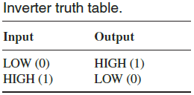

Logic Gates
NOT gate

Slide 17

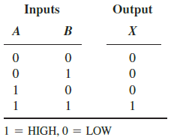
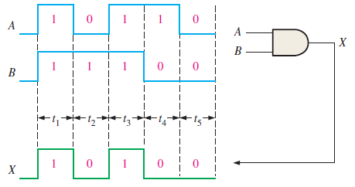
Logic Gates
AND gate

Slide 18

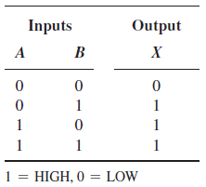
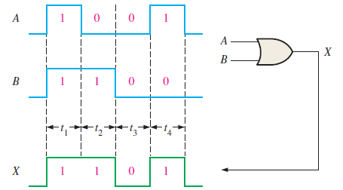
Logic Gates
OR gate

Slide 19


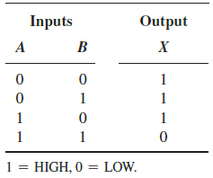
Logic Gates
NAND gate

Slide 20

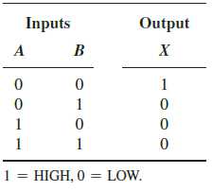
Logic Gates
NOR gate

Slide 21

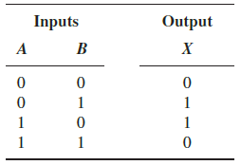
Logic Gates
XOR gate
X = A ⊕ B
Notes:
Exclusive OR

Slide 22

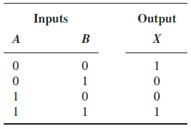
Logic Gates
XNOR gate
X = A ⊕ B

Slide 23
Axiom of logical algebra
Axiom | Addition | Multiplication
Commutative Law | A + B = B + A | A · B = B· A
Associative Law | A+(B+C)=(A+B)+C | A(BC) = (AB)C
Distributive Law | A(B+C)=AB+AC | (A+B).(A+C)=A+BC
Identity | A + 0 =A | A · 1 = A
Null | A + 1 = 1 | A · 0 = 0
Idempotency | A + A = A | A · A = A
Complementary | A + A’ = 1 | A · A’ = 0
Involution | (A’)’ = A

Slide 24
Other Basic Rules of Boolean Algebra
There are other basic rules of Boolean algebra that can be derived from the axioms in the previous table.
A + AB = A
A + A’ B = A + B
(A + B)(A + C) = A + B C

Slide 25
Example
Prove the following basic rules of Boolean algebra using the axiom of logical algebra.
A + AB = A
A + A’ B = A + B
(A + B)(A + C) = A + B C

Slide 26

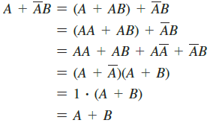
Solutions
Solution (a)
Solution (b)

Slide 27
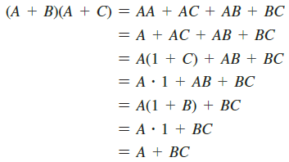
Solutions
Solution (c)

Slide 28
DeMorgan’s Theorem
DeMorgan’s Theorem can be used to convert a complement of an AND operation of two variables X and Y into an OR operation of the individual complement of X and Y, or vice versa, as follows:
It can also used to convert the complement of an OR operation of two variables X and Y into the AND of individual complement of X and Y, or vice versa, as follows:

Slide 29


DeMorgan’s Theorem (Continued)
DeMorgan’s Theorem can be extended to more than two variables as shown below:

Slide 30

Examples of Applying DeMorgan’s Theorem
Apply DeMorgan’s Theorem to each of the following expressions:

Slide 31
Variable, Literal, Complement
A variable is a symbol used to represent a condition with value of either 0 or 1. For example, in Boolean equation
Y = AB + CD. Each symbol Y, A, B, C and D is a variable.
A complement is used to represent an opposite logic value of a variable. If A = 1, the complement of A is 0, or vice versa. Usually (read as “A bar” or “not A”) is used to represent the complement of A.
A literal is a variable or a complement of a variable. For example, A is a literal, and is also a literal.
Note that is also written as A’.

Slide 32
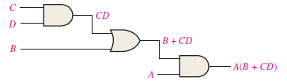
Boolean Equation for a Logic Circuit
Read the logic circuit from the inputs to the output of every logic gate.
We get the Boolean equation for the above logic circuit is
Z = A(B + CD)

Slide 33
Construct a Truth Table for a Logic Circuit
A | B | C | D | Z
0 | 0 | 0 | 0
0 | 0 | 0 | 1
0 | 0 | 1 | 0
0 | 0 | 1 | 1
0 | 1 | 0 | 0
0 | 1 | 0 | 1
0 | 1 | 1 | 0
0 | 1 | 1 | 1
1 | 0 | 0 | 0
1 | 0 | 0 | 1
1 | 0 | 1 | 0
1 | 0 | 1 | 1
1 | 1 | 0 | 0
1 | 1 | 0 | 1
1 | 1 | 1 | 0
1 | 1 | 1 | 1
For the logic equation in the previous slide, there are 4 inputs (A, B, C, D).
Therefore there are 16 (=2⁴) different combinations of inputs ABCD (from 0000 to 1111).
The truth table will have 16 input rows.

Slide 34
Evaluate the expression
From the logic equation Z = A(B + CD), check the values of the inputs A, B, C, D to get the output Z = 1.
The input A must be 1.
AND
either B or CD or BOTH must be 1.
When the term CD = 1, this implies C and D must be 1.
From the evaluation above, we conclude that for output Z to be 1, the input combination ABCD must be any of these: 1011, 1100, 1101, 1110, 1111.

Slide 35
Truth Table
A | B | C | D | Z
0 | 0 | 0 | 0 | 0
0 | 0 | 0 | 1 | 0
0 | 0 | 1 | 0 | 0
0 | 0 | 1 | 1 | 0
0 | 1 | 0 | 0 | 0
0 | 1 | 0 | 1 | 0
0 | 1 | 1 | 0 | 0
0 | 1 | 1 | 1 | 0
1 | 0 | 0 | 0 | 0
1 | 0 | 0 | 1 | 0
1 | 0 | 1 | 0 | 0
1 | 0 | 1 | 1 | 1
1 | 1 | 0 | 0 | 1
1 | 1 | 0 | 1 | 1
1 | 1 | 1 | 0 | 1
1 | 1 | 1 | 1 | 1
The complete truth table is
These input combinations produce output Z = 1

Slide 36

Any Questions

